Slide 1

Resume Project Challenge 1
- Rutesh Shinde

Slide 2

About the challenge
To counter declining market share, AtliQ Grands, a long-standing Indian luxury hotel chain, aims to revitalize by embracing "Business and Data Intelligence," despite lacking an in-house analytics team.

Slide 3
Challenge for who?
Anyone who wants to learn analytical
For the portfolio project
For practice what you have learn
To add some project on your resume
To get better and better
Presentation Title

Slide 4
Tools Used
MySQL
PowerPoint
For Analysis data using sql
PowerPoint for presentation
Power Bi
For data cleaning, transformation and building Dashboard
Excel
ChatGPT
A little bit Data cleaning and transformation
Using ChatGPT as my second brain and for problem statement

Slide 5
Data Set Includes
Dim Table
Dim_date
Dim_hotels
Dim_room
Fact Table
Fact_aggregated_bookings
Fact_bookings
Metric Table
Metrics_list
Others
Meta_data_hospitality
Mock up Dashboard

Slide 6
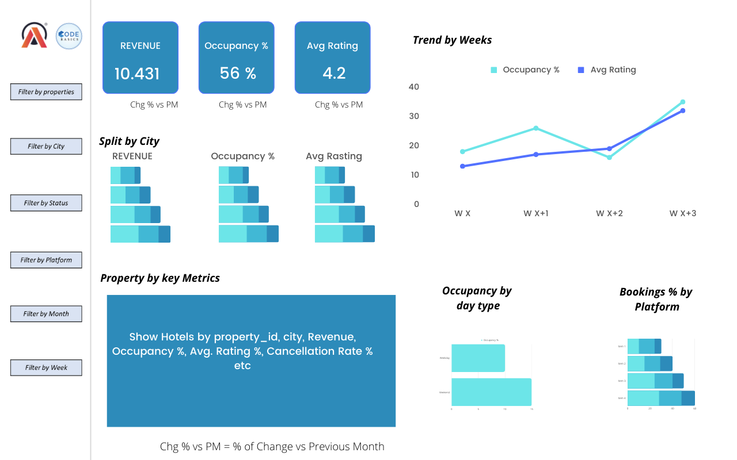
Mock up Dashboard

Slide 7
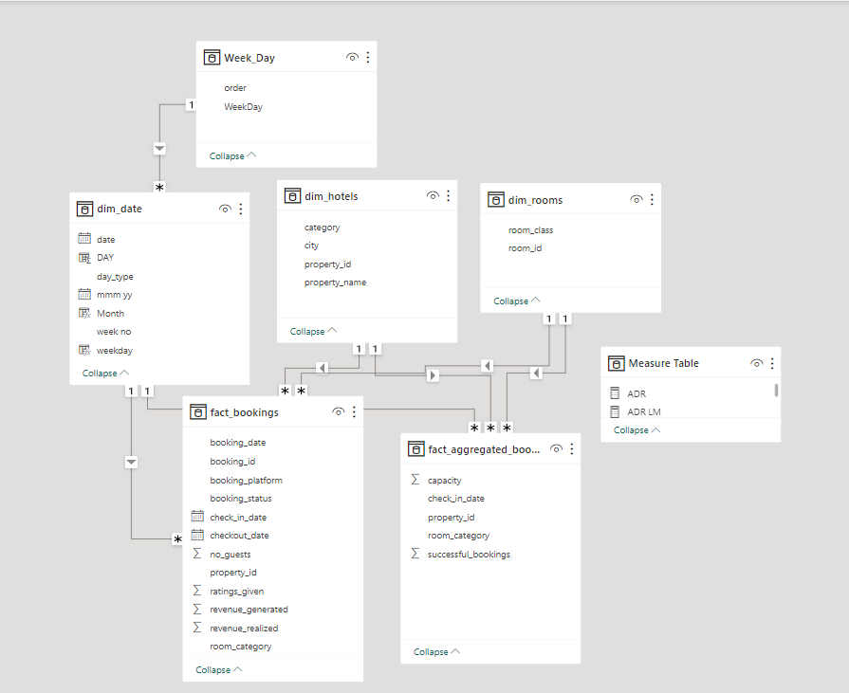
Data Modelling

Slide 8


Primary goals
Gain market share and revenue in the luxury/business

Slide 9

Two Division
Data Analysis with Power Bi
Data Analysis using Sql
Here we will be interacting with our Power Bi dashboard. Get some insects from that
Here we will be doing some analysis in MySQL. The problem statement we will give by ChatGPT

Slide 10
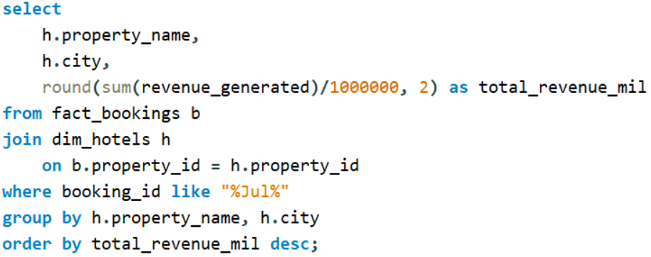
Write a SQL query to calculate the total revenue generated by each hotel for the month of July. Include the hotel name, city, and the total revenue generated. Order the results in descending order of total revenue.

Slide 11
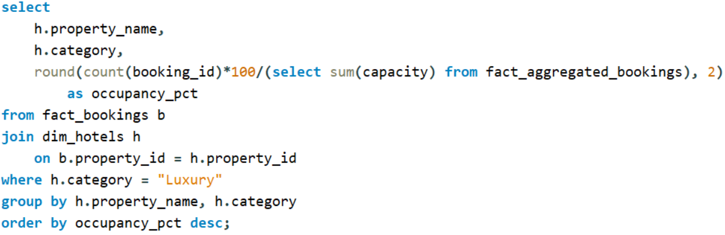
Write a SQL query to calculate the occupancy rate for each room type in the "Luxury" category hotels for the month of June. The occupancy rate is defined as the total number of booked room nights divided by the total available room nights for each room type. Include the room type, hotel name, and the occupancy rate. Order the results by the occupancy rate in descending order.

Slide 12
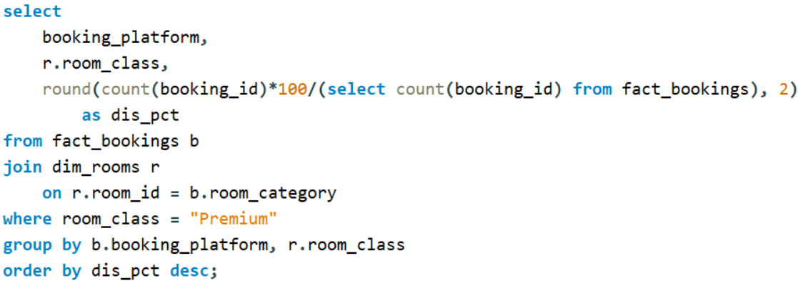
Write a SQL query to analyze the distribution of booking platforms used by customers for the "Premium" room category across all hotels. Calculate the percentage distribution of each booking platform (e.g., Online Travel Agencies, Hotel Website, Direct Booking, etc.) for the "Premium" room category. Include the room category, booking platform, and the percentage distribution. Order the results by the percentage distribution in descending order.

Slide 13
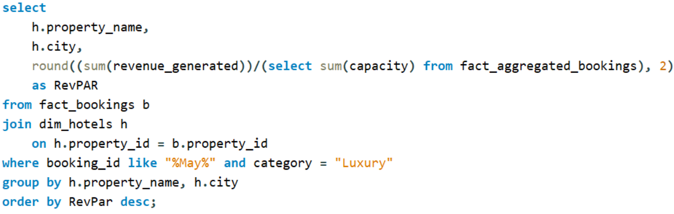
Write a SQL query to calculate the average revenue per available room (RevPAR) for each hotel in the "Luxury" category for the month of May. RevPAR is defined as the total revenue generated from room bookings divided by the total available room nights (revenue/capacity). Include the hotel name, city, and the calculated RevPAR. Order the results in descending order of RevPAR.

Slide 14




Thank you

